Slide 1
AI Driven RTL Derivation
CS 294-265
Angela Cui, Ferran Hermida-Rivera, Jack Toubes
2026-2–9

Slide 2
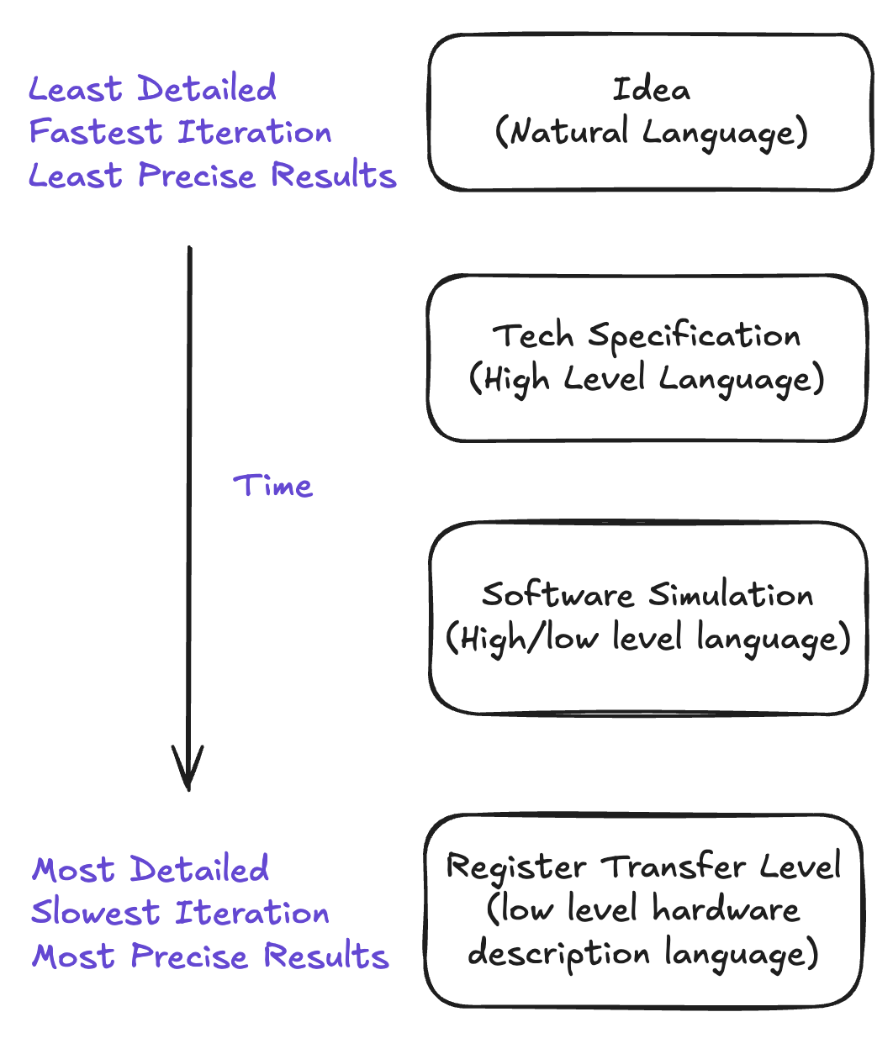
Motivation
Hardware design takes place in many steps
Later steps get more precise power, performance, and area estimations, but are harder to iterate on.
Accurately moving from step to step is slow, iterative, and error-prone.
Lots of published work in architecture doesn’t go beyond software simulation

Slide 3
Research Question
Can we use AI to move between these steps faster, automating a previously labor-intensive process?

Slide 4
Research Question
Can we use AI to move between these steps faster, automating a previously labor-intensive process?
Sub-questions
How do we design an agentic loop to perform digital circuit design?
What representation best enables AI to reason about digital circuits?
Can we bridge the gap between architects and people working on simulators?

Slide 5
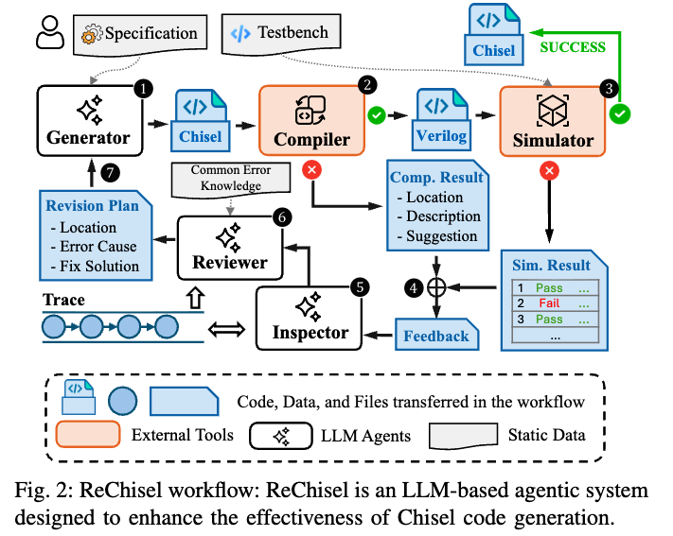
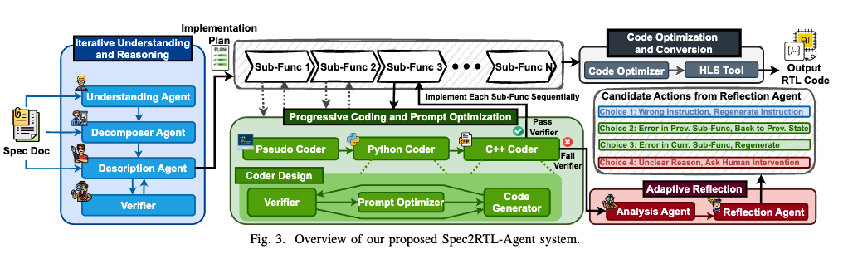
SOTA AI for RTL
Niu et al. DAC 2025
Yu et al. ICLAD 2025
Can we develop an agentic flow that reasons over the entire spec to RTL design process with ASIC QoR feedback?
Notes:
A
https://arxiv.org/pdf/2506.13905
https://ieeexplore.ieee.org/stamp/stamp.jsp?tp=&arnumber=11132940

Slide 6

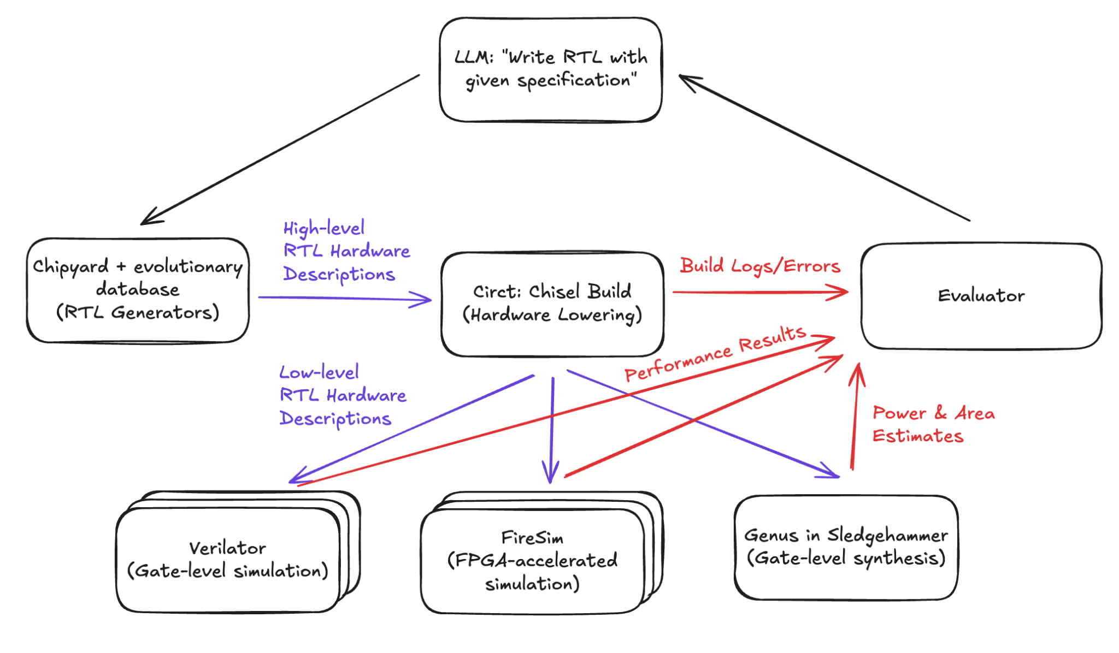
CHIA: CHipyard Intelligent Agents
Infrastructure for constructing arbitrary agentic flows for hardware design.
In active development in Slice lab
Simple Example Chia Flow
Notes:
SLICE lab is uniquely placed to tackle this research question because we already have the building blocks for agile hardware design in place
Can quickly give LLM agent high-fidelity feedback
Support arbitrary dataflows
Distribute over heterogeneous resources
Fault tolerant

Slide 7
A strawman graph abstraction for describing arbitrary HW/SW co-design flows
Concrete node types:
Chisel elaboration
SW simulators
HW-accel simulators
FIRRTL passes
SW stack build / co-opt for target design (bare metal, zephyr, linux, etc.)
CAD tools
Verification tools
LLM API calls
Local model calls
Proprietary data filters
Evolutionary algorithm primitives
Humans
Subgraph node (composition/CHIA “libraries”)
Databases
…
Abstract node types:
Simulators
RTL gen
ASIC Syn, par, etc.
LLM Calls (e.g., w/ a caching layer)
…
Edges: Describe data flow, dependencies, parallel fork/join between nodes
Many open questions:
Is logging a feature of a node or edge?
How cleanly can we define APIs on these?
  E.g., how do we expose the code that an LLM may want to modify?
…
Notes:
We can abstract flows as graphs where nodes are specific tasks and edges represent data flow and dependencies
User can easily custom-build graphs for design task at hand.
And connect them with well-defined input and output types
The framework would also have built-in sanity checking (like type checking on graph edges) rather than writing random scripts
Reiterate that “make” on a single machine is not going to cut it for any of this

Slide 8
What are we actually going to do
Use CHIA to perform
Alignment: how well does gem5 align with BOOM?
Implementation of RTL from
  Natural language descriptions of hardware (of varying detail)
  Software simulator (gem5) implementations
Targets for RTL derivation:
  Suite of uarch publications + open-sourced gem5 implementation
  E.g. Hawkeye (cache replacement policy)
Target metrics:
  Functional correctness with unit tests and/or formal verification
  ASIC flow QoR

Slide 9
Infrastructure
Ray: distributed framework for AI applications
Gem5: an event-driven computer-system architecture simulator
Chipyard: an integrated SoC design, simulation and implementation framework
  Chisel: a scala-based hardware description language
Verilator: cycle-accurate hardware simulator
FireSim: a FPGA-accelerated full-system hardware simulation platform
SledgeHammer: an agile physical design framework

Slide 10
Verification & Evaluators
Functional correctness: Do the outputs of this block align with the spec?
  Unit testing
  Formal verification
  Various benchmarks (ubenchs, coremark/mbench, spec)
Performance correctness: Does the PPA (performance, power, area) of this block align with the spec?
  More open ended…
  Could compare with existing RTL implementations for a given spec
  Commercial gate-level synthesis for detailed power and area analysis
  Benchmarks
Notes:
Of course, evaluation is a core part of this project: specifically Functional correctness and performance correctness
Microbench: https://research.cs.wisc.edu/vertical/wiki/index.php/microbench/microbench

Slide 11
Roadmap
Develop AI flow loop in CHIA
  Develop CHIA nodes for necessary infrastructure
  Prompts and evaluators
Find suitable examples with natural language descriptions (e.g. research papers), software simulator descriptions, and RTL implementations.
Run flow with gem5 and BOOM, evaluate QoR and correctness, iterate on flow (prompts, evaluators, model, parameters, etc)
Notes:
Run flow with gem5 and BOOM -> we want to apply the translation flow that we have developed in 1 to implement optimizations we find in 2 in the BOOM core. Hopefully, the finally implementation will be at least as good as the RTL we have from 2.

